Slide 1

TownRate
School of Future Tech
CASE STUDY 95 · BACKEND DEVELOPMENT
Local Business Review Platform — a REST API built with Node.js, Express, MongoDB and Firebase
Aditya Sunil Chouksey
150096725070 · B.Tech Computer Science Engineering
Notes:
Good morning. I am Aditya Sunil Chouksey, and my case study is TownRate – the backend for a local business review platform, built with Node.js, Express, MongoDB and Firebase. Transition: "Let me start with the problem it solves."

Slide 2
People need to find – and trust – local businesses
THE PROBLEM
Owners
Users
Fairness
Need a simple profile with photos, and a way to reply to reviews.
Need to search by keyword, category or location – and see what is near them.
One review per person, no self-reviews, an average rating that is always correct.
TownRate · Case Study 95 · 02
Notes:
Communities want to discover and review local businesses. The PS asks for an API where owners publish profiles with photos, users search by category or location, and everyone can rate and review. The hard part is keeping it fair and consistent – one review per user, owners cannot rate themselves, and the average rating must always be correct. Transition: "Here is exactly what the problem statement asked for."

Slide 3
Every requirement is covered
SCOPE
Requirement from the problem statement | Status
Node.js + Express REST API with modular routes and controllers | Done
MongoDB with Mongoose: users, businesses, reviews (+ categories) | Done
JWT authentication + Firebase Auth | Done
Firebase Storage for business photos | Done
Middleware: JWT, file upload, validation | Done
Endpoints: auth, businesses, reviews, categories, search | Done
Optional: "near me" search · owner response to reviews | Both done
Swagger + Postman docs · GitHub README | Done
Bonus: deployment on Render | Deployed
TownRate · Case Study 95 · 03
Notes:
Every required endpoint is implemented – auth, businesses, reviews, categories and search – plus both optional features. I added delete endpoints to complete CRUD, roles, a health check and automated tests. Documentation is provided as both Swagger and a Postman collection, and the API is deployed on Render. Transition: "How does a request move through the system?"

Slide 4
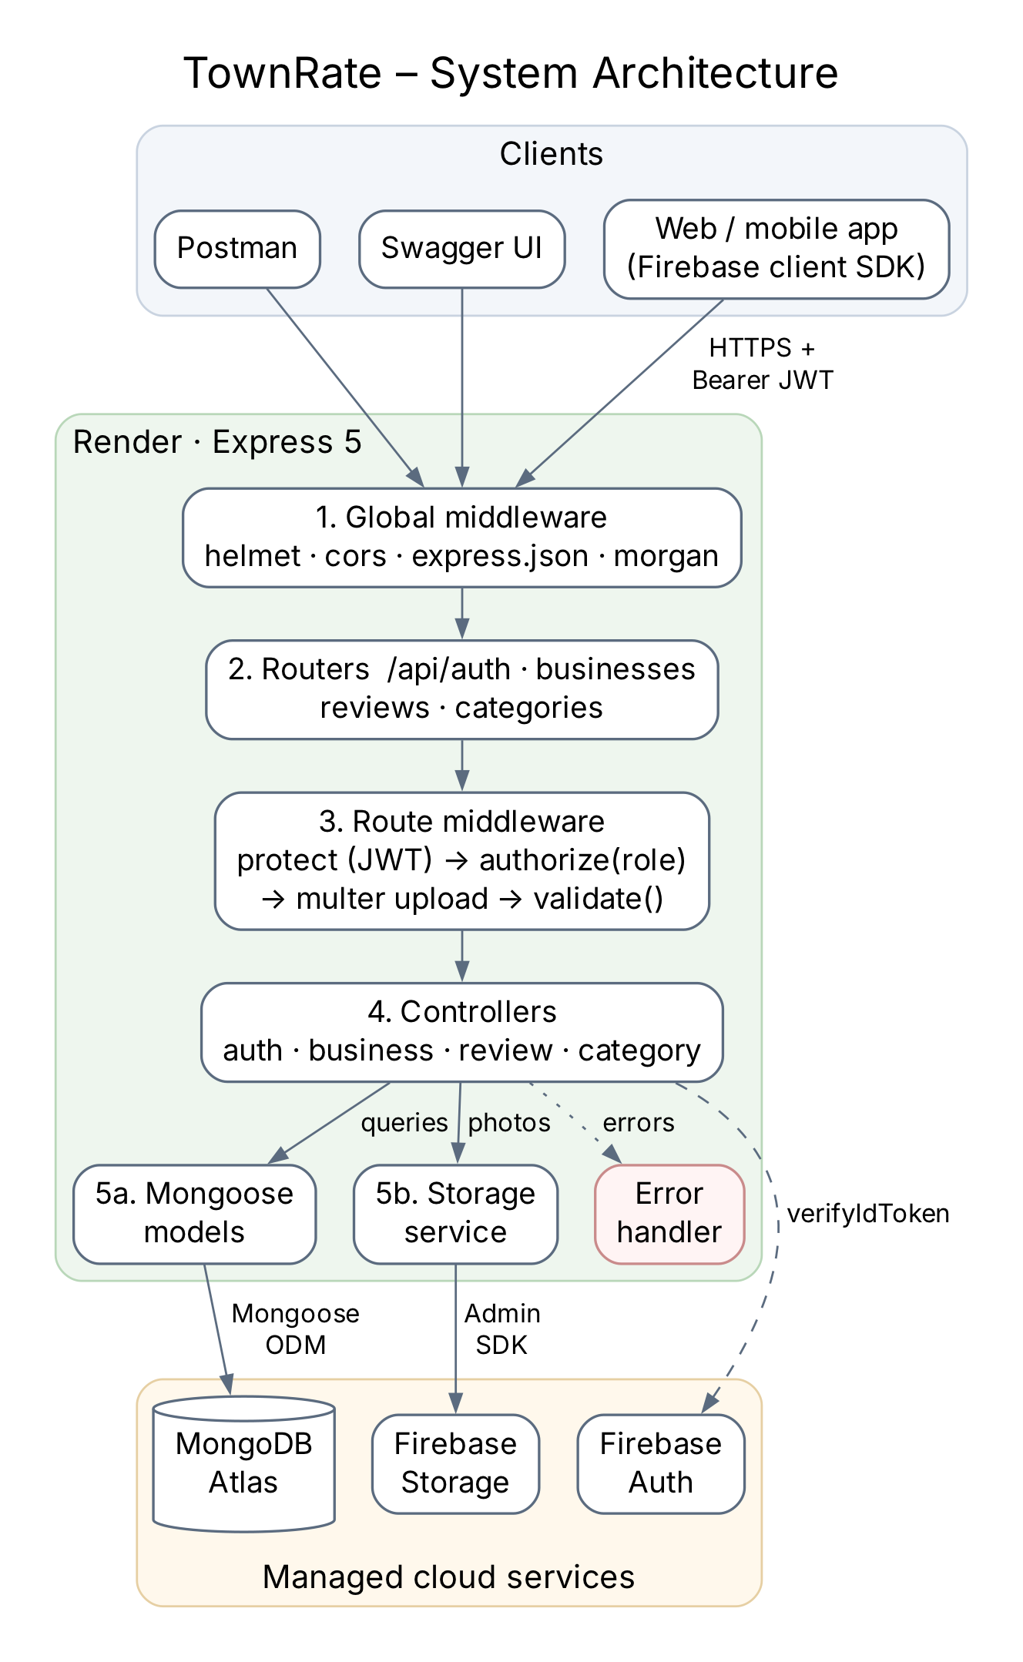
A request passes through five layers
ARCHITECTURE
Global middleware – helmet, cors, JSON parsing, logging
Routers – one per resource under /api
Route middleware – JWT → role → upload → validation
Controllers – the business rules
Models & storage – MongoDB Atlas and Firebase
Every error ends in one handler → the same JSON shape everywhere.
TownRate · Case Study 95 · 04
Notes:
Requests pass through layers. Global middleware adds security headers and parses JSON. The router picks the chain for the URL. Route middleware checks the token, the role, parses uploads and validates input. Controllers contain the business rules, models talk to MongoDB Atlas, and the storage service sends photos to Firebase. Any error goes to one error handler, so every error looks the same. Transition: "The data model behind it:"

Slide 5
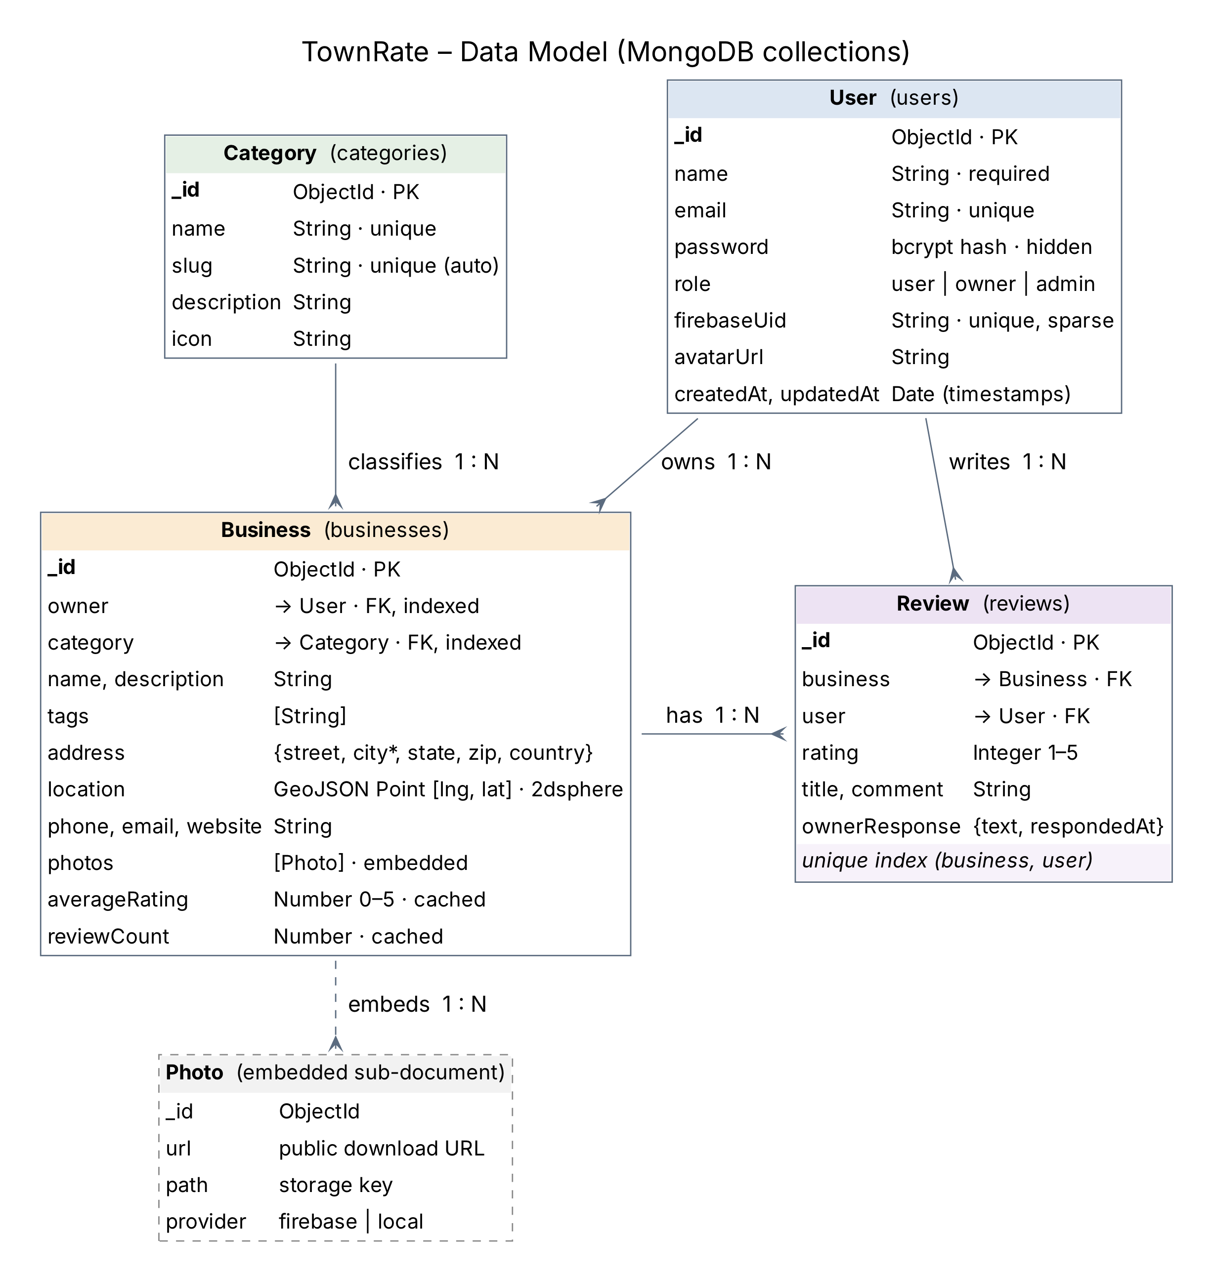
Four collections
DATA MODEL
Referenced: owner and category on a business; a review points to its business and user
Embedded: photos live inside the business (at most 10)
Cached: averageRating and reviewCount for fast sorting
Unique index on (business, user): one review each, even under simultaneous requests
TownRate · Case Study 95 · 05
Notes:
Four collections. Reviews are a separate collection because they grow without limit and are queried on their own; photos are embedded because they are few and always shown with the business. The average rating is cached on the business so lists sort fast, and a unique compound index guarantees one review per user per business even under simultaneous requests. Transition: "Next, who is allowed to do what."

Slide 6
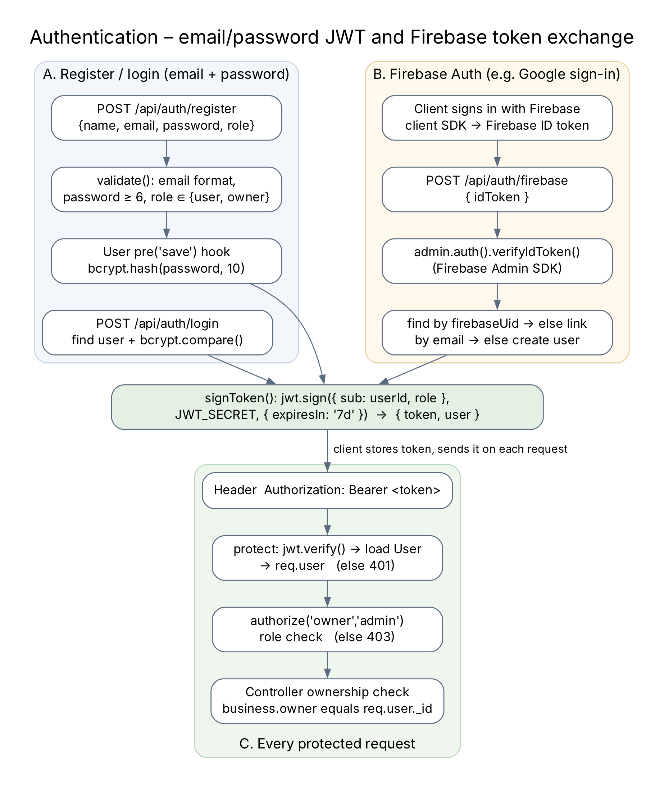
Two ways in, one token
SECURITY
Passwords hashed with bcrypt (cost 10)
JWT { sub, role } · 7-day expiry · Bearer header
Firebase ID token verified once → the same JWT
Roles: user · owner · admin
Ownership checks – owners edit only their own business
helmet, cors, secrets only in environment variables
TownRate · Case Study 95 · 06
Notes:
Passwords are hashed with bcrypt. Login returns a signed JWT that the client sends as a Bearer token. Users who sign in with Firebase send their Firebase token once; the server verifies it with the Admin SDK and gives them the same JWT. Roles decide what an account may do, and controllers also check ownership – an owner can only edit their own business. Transition: "Now the features users actually see."

Slide 7
Search, near me and fair ratings
FEATURES
Keyword search
Near me
Reviews
Escaped regex over name, description, tags, city and category name.
GeoJSON points + 2dsphere index; $geoNear returns nearest first with distanceKm.
One review per user; an aggregation recalculates the average; owners can reply.
/search?keyword=cafe
/near?lat=…&lng=…
POST /api/reviews
TownRate · Case Study 95 · 07
Notes:
Search escapes the keyword and matches several fields, including the category name, so "cafe" finds every cafe. Near-me search stores longitude and latitude as GeoJSON and uses $geoNear to return businesses within the radius, nearest first. Each review triggers an aggregation that recalculates the average, and owners can reply to reviews. Transition: "Photos are handled like this."

Slide 8

Photos: validate first, roll back on failure
FIREBASE STORAGE
STEP 1
STEP 2
STEP 3
STEP 4
multer
Validate
Upload
Save
Images only, 5 MB each, 5 per request
The business is checked before any upload
Firebase Storage with a private download token
If saving fails, the uploaded files are deleted
Without Firebase credentials the API still runs – photos fall back to local disk and /api/health says so.
TownRate · Case Study 95 · 08
Notes:
multer reads the upload in memory and rejects anything that is not an image or is too large. The business is validated first, then photos go to Firebase Storage with a private download token, and if saving fails the files are deleted again so nothing is left behind. Transition: "How do we know it works?"

Slide 9
How we know it works
DOCUMENTATION & TESTING
41
41
OpenAPI
automated tests – unit + end-to-end with supertest
Postman requests, chained with saved tokens and ids
Swagger UI served by the API at /api-docs
Tests cover login, roles, validation, uploads, search, geo search, rating updates, owner replies and errors – on a separate test database.
TownRate · Case Study 95 · 09
Notes:
The API documents itself with Swagger at /api-docs. The Postman collection runs the whole scenario automatically, passing tokens and ids between requests. There are 41 automated tests covering auth, roles, validation, uploads, search, geo search, ratings and errors. Transition: "Finally, deployment and results."

Slide 10
Render + MongoDB Atlas
DEPLOYMENT
render.yaml Blueprint: npm ci → npm start
Health check on /api/health
Secrets in Render environment variables, never in Git
Database: MongoDB Atlas free cluster
GET /api/health – expected response
{
"status": "ok",
"database": "connected",
"firebaseAuth": "enabled",
"photoStorage": "firebase"
}
Live: [Render URL]
TownRate · Case Study 95 · 10
Notes:
The service runs on Render from the GitHub repository using a Blueprint file, with MongoDB Atlas as the database and all secrets in environment variables. The health endpoint reports the database and Firebase status. Transition: "To conclude…"

Slide 11
All requirements met, both optional features built
CONCLUSION
Delivered
Next steps
REST API with full CRUD and roles
Search, near me, ratings, owner replies
Photos in Firebase Storage
Swagger, Postman, 41 tests, Render
Rate limiting and refresh tokens
Image thumbnails
Atlas Search for ranking
A web or mobile frontend
Thank you – questions?
TownRate · Case Study 95 · 11
Notes:
TownRate meets every requirement of the case study including both optional features. Next steps would be rate limiting, refresh tokens, image thumbnails, smarter search and a frontend. Thank you – I am happy to take questions.

